Slide 1
Virtual Memory
Segmentation

Slide 2
Segmentation (1)
The virtual memory discussed so far is one-dimensional because the virtual addresses go from 0 to some maximum address, one address after another. For many problems, having two or more separate virtual address spaces may be much better than having only one. For example, a compiler has many tables that are built up as compilation proceeds, possibly including
1. The source text being saved for the printed listing (on batch systems).
2. The symbol table, containing the names and attributes of variables.
3. The table containing all the integer and floating-point constants used.
4. The parse tree, containing the syntactic analysis of the program.
5. The stack used for procedure calls within the compiler.
1

Slide 3
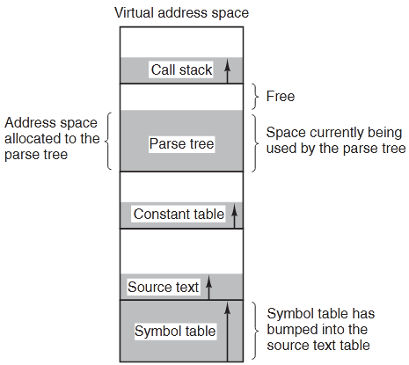
Segmentation (2)
Each of the first four tables grows continuously as compilation proceeds. The last one grows and shrinks in unpredictable ways during compilation. In a one-dimensional memory, these five tables
would have to be allocated contiguous chunks of virtual address space, as in Fig below:
In a one-dimensional address space with growing tables, one table may bump into another.
A straightforward and quite general solution is to provide the machine with many completely independent address spaces, which are called segments. Each segment consists of a linear sequence of addresses, starting at 0 and going up to some maximum value. The length of each segment may be anything from 0 to the maximum address allowed.

Slide 4
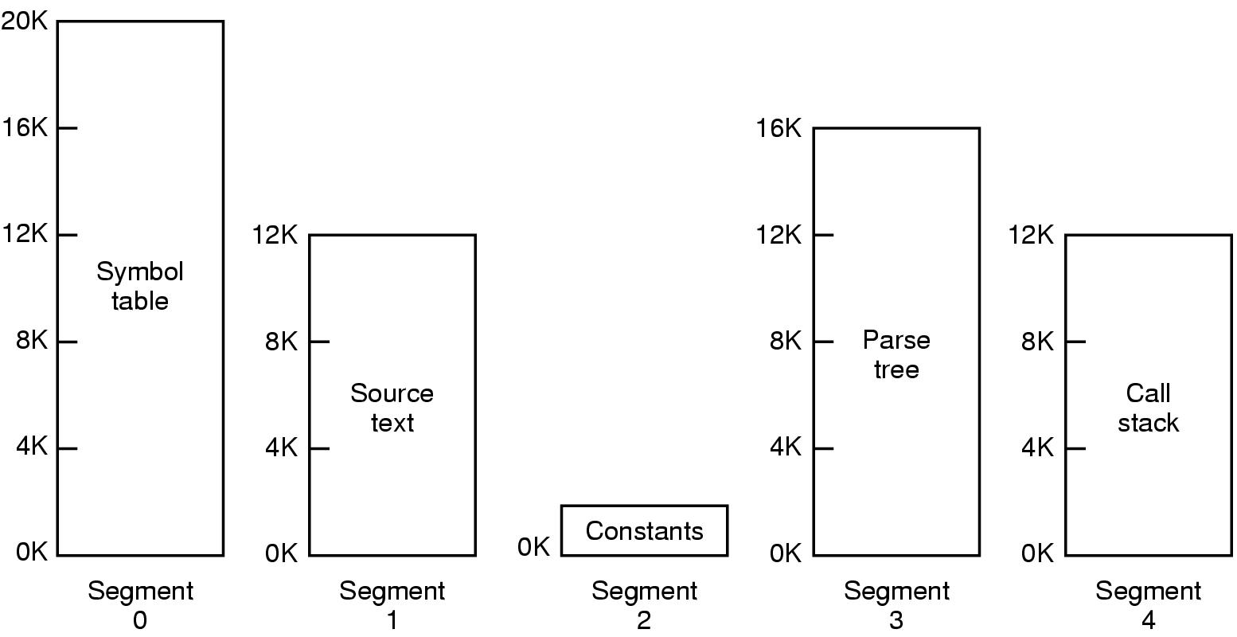
Segmentation (3)
Because each segment constitutes a separate address space, different segments can grow or shrink independently without affecting each other.
A segmented memory allows each table to grow or shrink independently of the other tables.

Slide 5

Compare paging and segmentation
Comparison of paging and segmentation

Slide 6
Implementation of Pure Segmentation (1)
The implementation of segmentation differs from paging in an essential way: pages are of fixed size and segments are not.
After the system has been running for a while, memory will be divided up into a number of chunks, some containing segments and some containing holes. This phenomenon, called checkerboarding or external fragmentation, wastes memory in the holes. It can be dealt with by compaction.

Slide 7
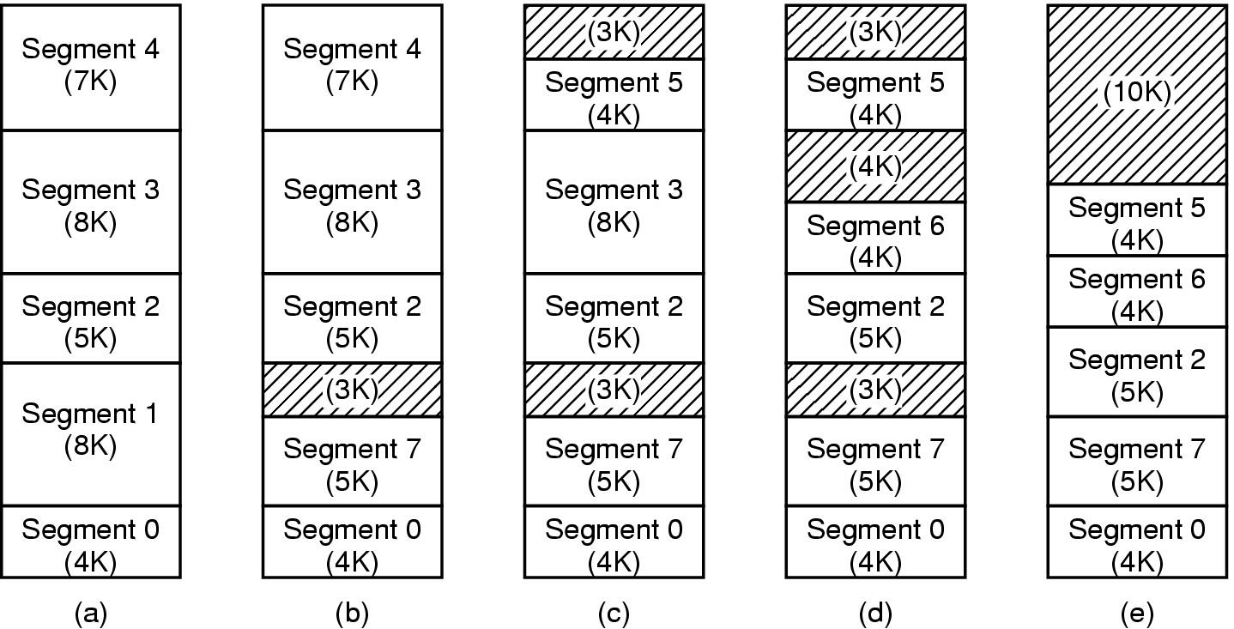
Implementation of Pure Segmentation (2)
(a)-(d) Development of checkerboarding
(e) Removal of the checkerboarding by compaction

Slide 8
Segmentation with Paging: MULTICS (1)
Segmentation with Paging: MULTICS (1)
If the segments are large, it may be inconvenient, or even impossible, to keep them in main memory in their entirety. This leads to the idea of paging them, so that only those pages of a segment that are actually needed have to be around. Several significant systems have supported paged segments. In this section we will
describe the first one: MULTICS. In the next one we will discuss a more recent one: the Intel x86 up until the x86-64.
Multics (Multiplexed Information and Computing Service) was a mainframe time-sharing operating system that was developed in the 1963-1969 period through the collaboration of the Massachusetts Institute of Technology (MIT), General Electric (GE), and Bell Labs. Multics was the first or one of the first operating systems that used page-segmented storage

Slide 9
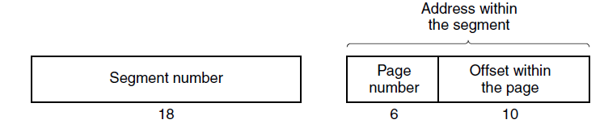
Segmentation with Paging: MULTICS (2)
The MULTICS operating system was one of the most influential operating systems ever. The last MULTICS system was shut down in 2000, a run of 31 years. Each MULTICS program had a segment table, with one descriptor per segment. Each segment was an ordinary virtual address space and was paged in the same way as the nonsegmented paged memory described earlier in this chapter. An address in MULTICS consisted of two parts: the segment and the address within the segment. The address within the segment was further divided into a page number and a word within the page.
A 34-bit MULTICS virtual address.

Slide 10
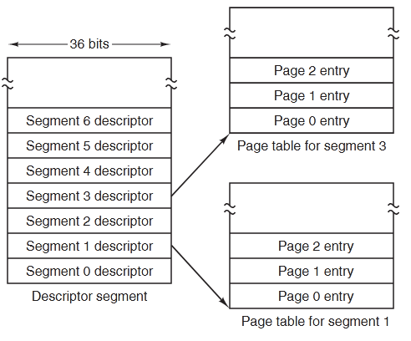
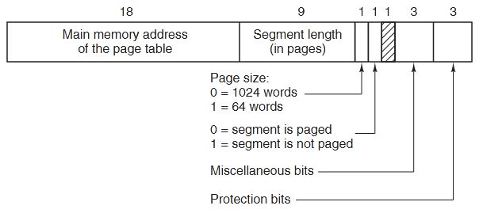
Segmentation with Paging: MULTICS (3)
The MULTICS virtual memory
(b) A segment descriptor. The numbers are the field lengths.
(a) The segment descriptor pointed to the page tables.

Slide 11
Segmentation with Paging: Pentium (1)
The memory management system of the Intel Architecture processors (Pentium: Pro, II, III and 4) is divided into two parts: segmentation and paging. Segmentation provides a mechanism of isolating individual code, data, and stack modules so that multiple programs (or tasks) can run on the same processor without interfering with one another. Paging provides a mechanism for implementing a demand-paged virtual memory system, where sections of a program’s execution environment are mapped into physical memory as needed. When the processor operates in protected mode, some form of segmentation must be used. There is no mode bit to disable segmentation. The use of paging, however, is optional.
The Intel Architecture has three address spaces: virtual, linear, and physical. Figure in next slide represents the relationship between these address spaces. The segmentation unit translates a virtual address into a linear address. When the paging is not used, the linear address corresponds to the physical address. When paging is used, the paging unit translates the linear address into a physical address.

Slide 12
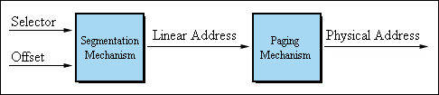
Segmentation with Paging: Pentium (2)

Slide 13
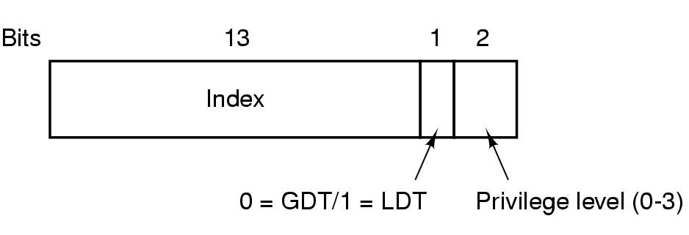
Segmentation with Paging: Pentium (3)
A Pentium selector
GDT (Global Descriptor Table), LDT (Local Descriptor Table)

Slide 14
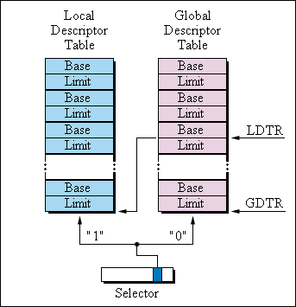
Segmentation with Paging: Pentium (4)
GDT (Global Descriptor Table) is used mainly for holding descriptor entries of operating system segments. example kernel stack, code_section/data_section.
LDT (Local Descriptor Table) contains entries of normal application segments (although not necessarily) user stack, code_section/data_section.

Slide 15
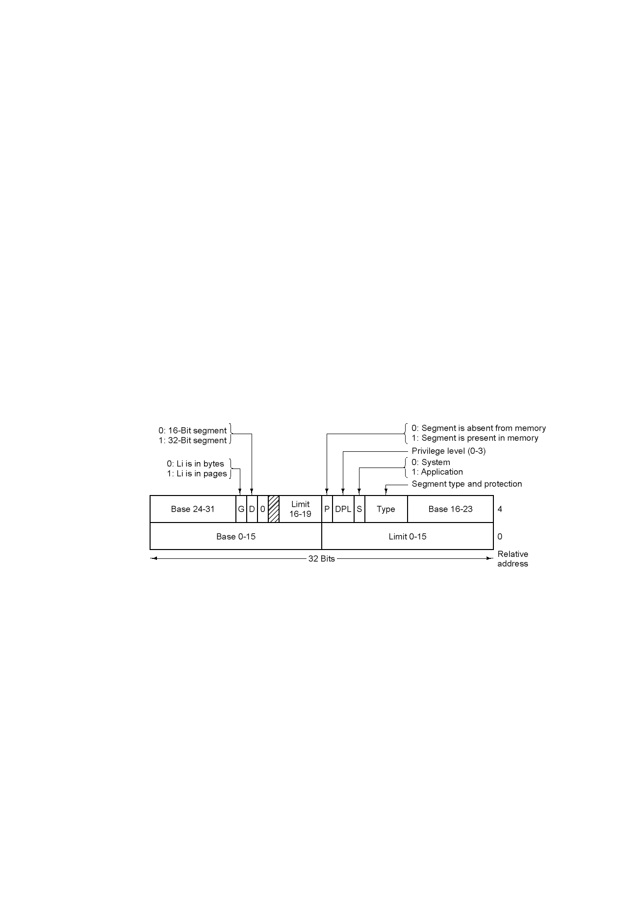
Segmentation with Paging: Pentium (5)
Pentium code segment descriptor
Data segments differ slightly

Slide 16
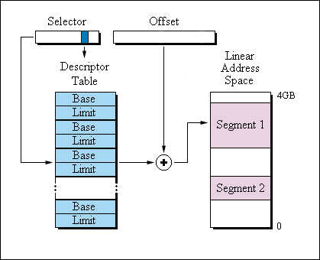
Segmentation with Paging: Pentium (6)

Slide 17
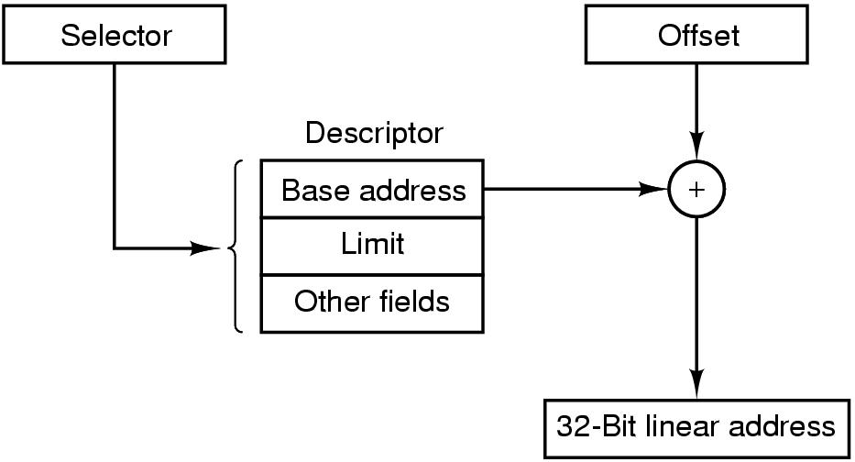
Segmentation with Paging: Pentium (7)
Conversion of a (selector, offset) pair to a linear address

Slide 18
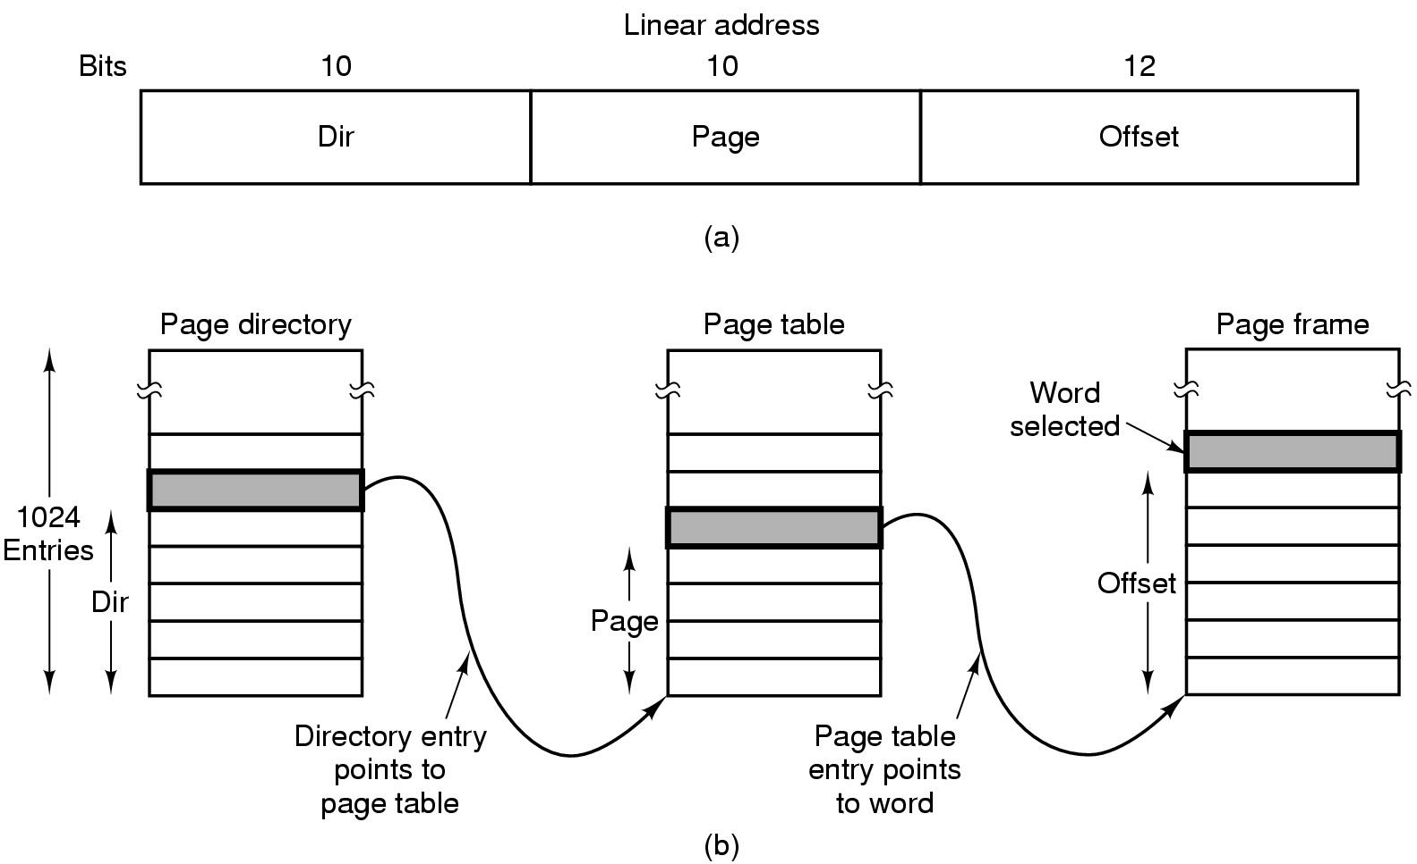
Segmentation with Paging: Pentium (8)
Mapping of a linear address onto a physical address

Slide 19
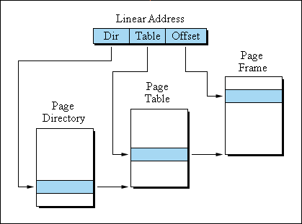
Segmentation with Paging: Pentium (9)

Slide 20
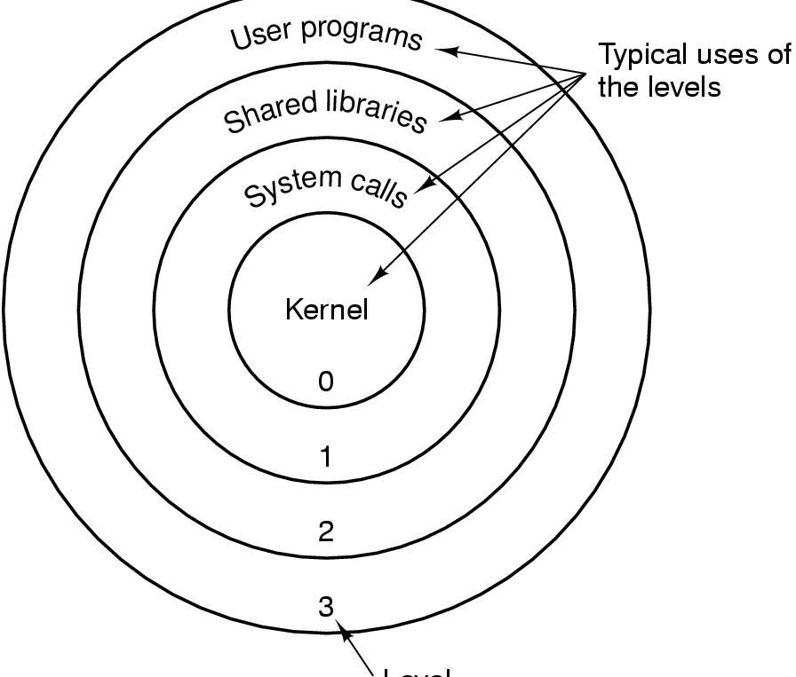
Segmentation with Paging: Pentium (10)
Level
Protection on the Pentium

